Slide 1
CS4104 Machine Learning
K Nearest Neighbors Classifier (KNN)

Slide 2
Instance Based Learning
First Example of Supervised Classification
Rote-learner
Memorizes entire training data and performs classification only if attributes of record match one of the training examples exactly
Nearest neighbor
Uses k “closest” points (nearest neighbors) for performing classification

Slide 3
Instance Based Learning
Labeled Data
Unlabeled Data
Att1 | Att2 | Class
1 | 2 | A
5 | 7 | B
2 | 5 | A
4 | 2 | B
Att1 | Att2 | Class
1 | 2 | ?
2 | 6 | ?
3 | 4 | ?

Slide 4
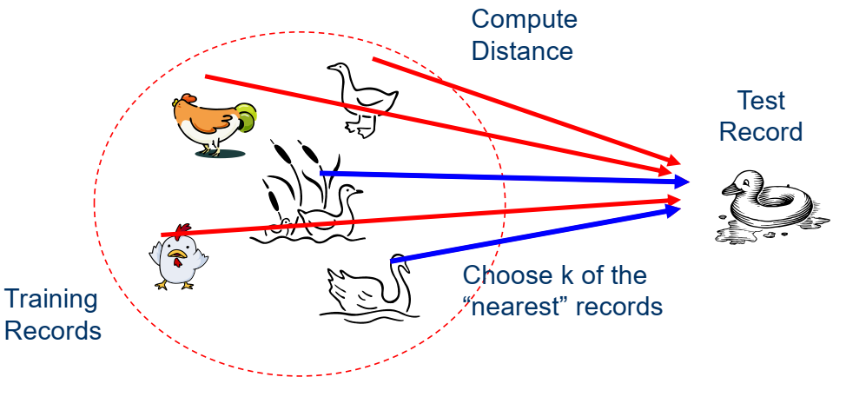
Nearest Neighbors

Slide 5
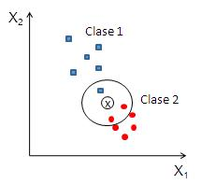
K Nearest Neighbors
Requires three things
The set of stored records
Distance Metric to compute distance between records
The value of k, the number of nearest neighbors to retrieve
To classify an unknown record:
Compute distance to other training records
Identify k nearest neighbors
Use class labels of nearest neighbors to determine the class label of unknown record (e.g., by taking majority vote)

Slide 6
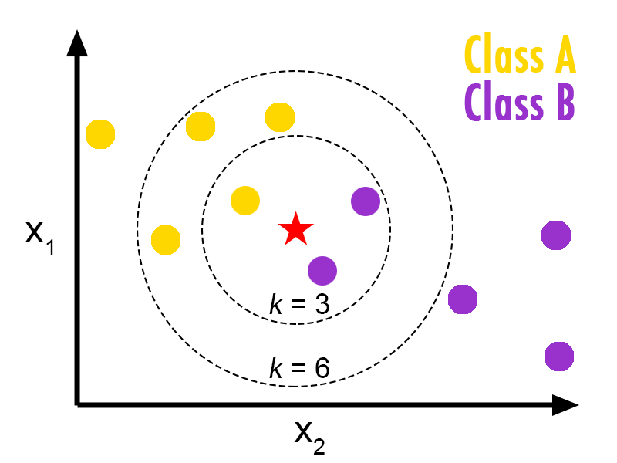
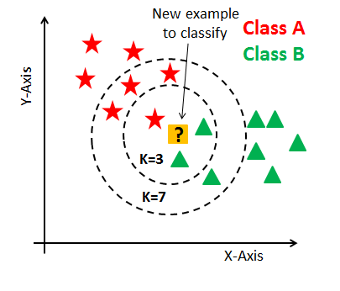
K Nearest Neighbors (KNN)

Slide 7
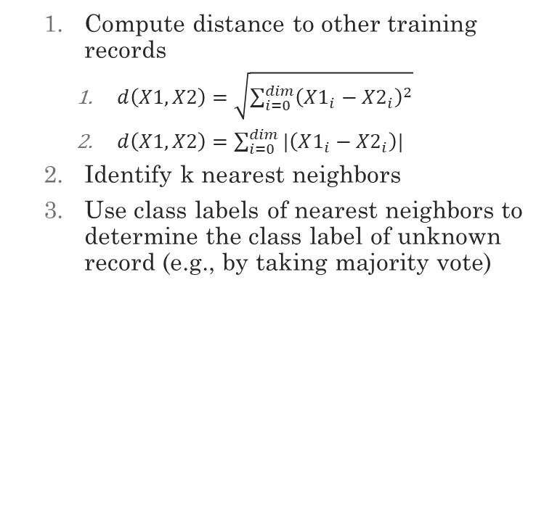
K Nearest Neighbors
Compute distance to other training records
$d\left(X1,X2\right)=\sqrt{\sum_{i=0}^{dim}{{\left(X1_{i}−X2_{i}\right)}^{2}}}$
$d\left(X1,X2\right)=\sum_{i=0}^{dim}{{|\left(X1_{i}−X2_{i}\right)|}^{}}$
Identify k nearest neighbors
Use class labels of nearest neighbors to determine the class label of unknown record (e.g., by taking majority vote)

Slide 8
Example
X1 | X2 | Class
1 | 3 | B
2 | 4 | B
3 | 2 | A
5 | 4 | A
2 | 5 | ?
Assuming Distance as city block distance

Slide 9
Example
X1 | X2 | Class | Distance
1 | 3 | B
2 | 4 | B
3 | 2 | A
5 | 4 | A
2 | 5 | ?
Compute distance to other training records
Identify k nearest neighbors
Use class labels of nearest neighbors to determine the class label of unknown record (e.g., by taking majority vote)
|2-1|+|5-3|=3
|2-2|+|5-4|=1
|2-3|+|5-2|=4
|2-5|+|5-4|=4

Slide 10
Example (k=1)
X1 | X2 | Class | Distance
1 | 3 | B
2 | 4 | B
3 | 2 | A
5 | 4 | A
2 | 5 | ?
Compute distance to other training records
Identify k nearest neighbors
Use class labels of nearest neighbors to determine the class label of unknown record (e.g., by taking majority vote)
|2-1|+|5-3|=3
|2-2|+|5-4|=1
|2-3|+|5-2|=4
|2-5|+|5-4|=4

Slide 11
Example (k=2)
X1 | X2 | Class | Distance
1 | 3 | B
2 | 4 | B
3 | 2 | A
5 | 4 | A
2 | 5 | ?
Compute distance to other training records
Identify k nearest neighbors
Use class labels of nearest neighbors to determine the class label of unknown record (e.g., by taking majority vote)
|2-1|+|5-3|=3
|2-2|+|5-4|=1
|2-3|+|5-2|=4
|2-5|+|5-4|=4

Slide 12
Example (k=1,2)
X1 | X2 | Class | Distance
1 | 3 | B
2 | 4 | B
3 | 2 | A
5 | 4 | A
2 | 5 | B
Compute distance to other training records
Identify k nearest neighbors
Use class labels of nearest neighbors to determine the class label of unknown record (e.g., by taking majority vote)
|2-1|+|5-3|=3
|2-2|+|5-4|=1
|2-3|+|5-2|=4
|2-5|+|5-4|=4

Slide 13
KNN Code
Constructor
Train
Test

Slide 14
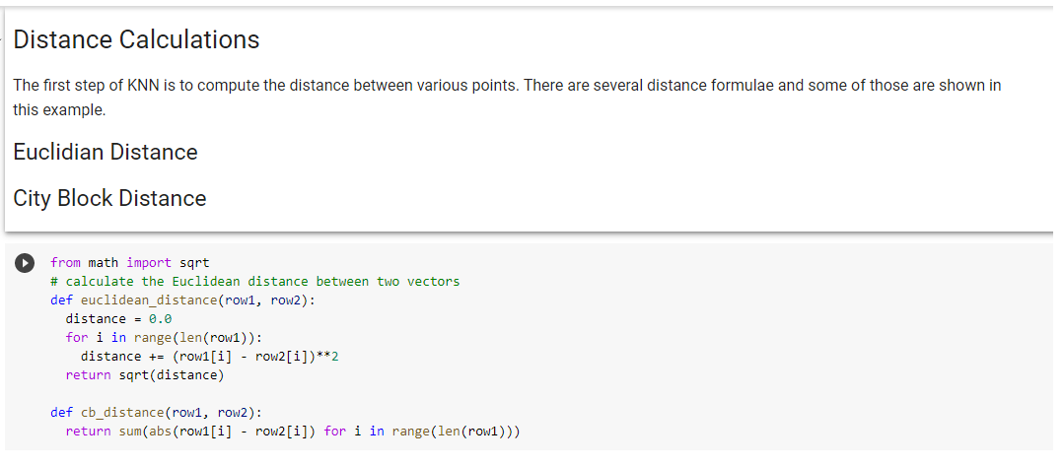
Distance

Slide 15
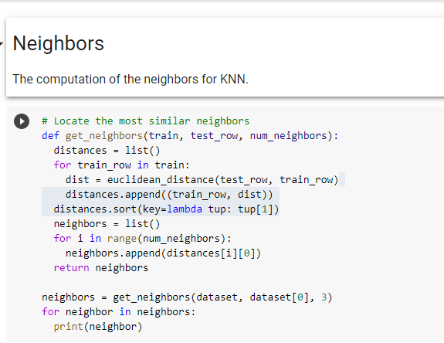
Neighbors

Slide 16
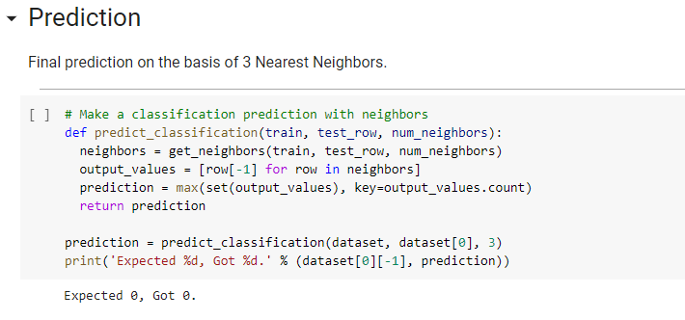
Prediction

Slide 17
CS40104 Applied Machine Learning
Issues in KNN

Slide 18
Scale Effects
Different features may have different measurement scales
E.g., patient weight in kg (range [50,200]) vs. blood protein values in ng/dL (range [-3,3])
Consequences
Patient weight will have a much greater influence on the distance between samples
May bias the performance of the classifier

Slide 19
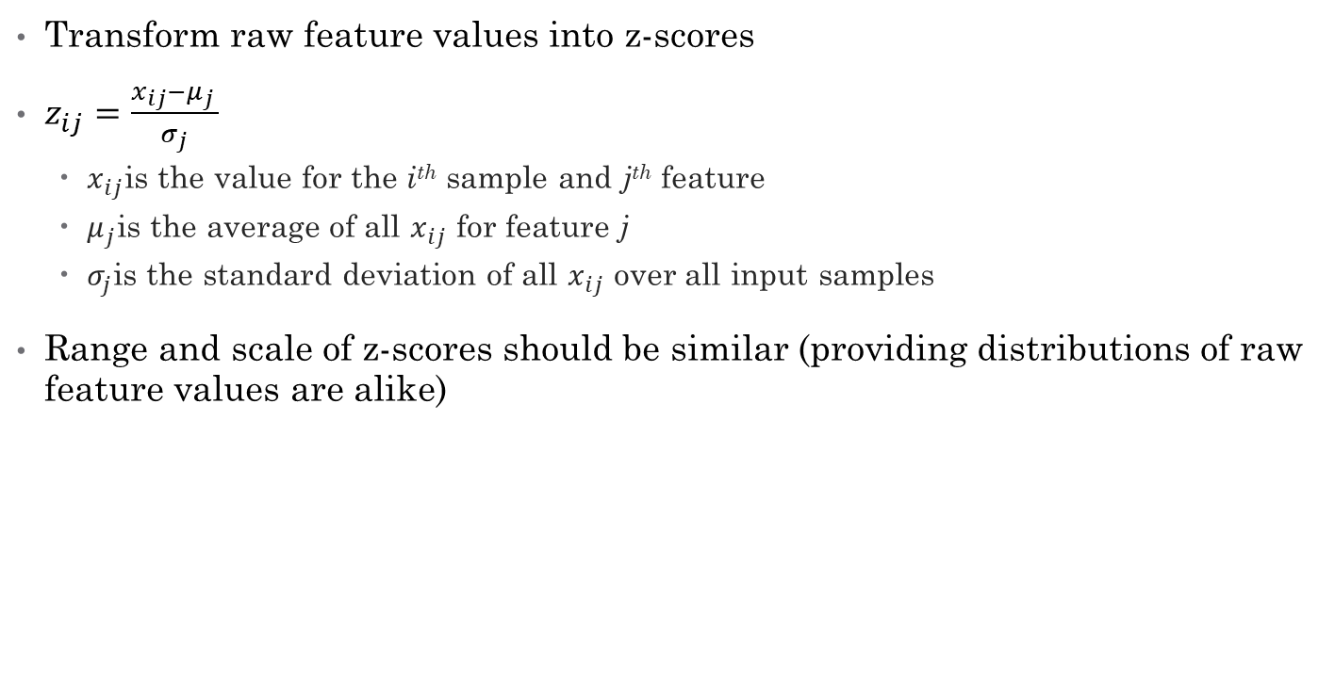
Standardization
Transform raw feature values into z-scores
$z_{ij}=\frac{x_{ij}−μ_{j} }{σ_{j}}$
$x_{ij}$is the value for the i^{th} sample and j^{th} feature
$μ_{j}$is the average of all $x_{ij}$ for feature j
$σ_{j}$is the standard deviation of all $x_{ij}$ over all input samples
Range and scale of z-scores should be similar (providing distributions of raw feature values are alike)

Slide 20
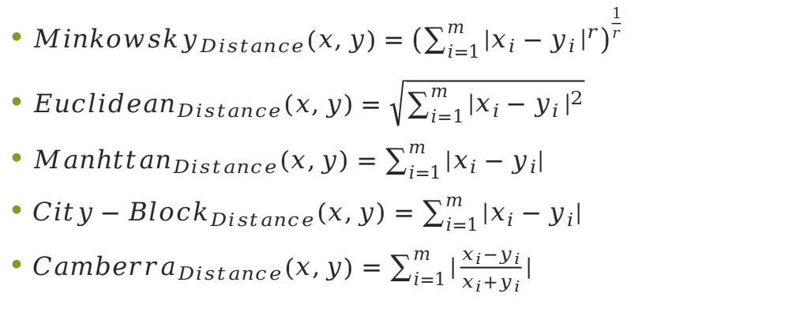
Distance Metrics
$Minkowsky_{Distance}\left(x,y\right)={\left(\sum_{i=1}^{m}{|x_{i}−y_{i}}{\left.​\right|}^{r}\right)}^{\frac{1}{r}}$
${Euclidean}_{Distance}(x,y)=\sqrt{\sum_{i=1}^{m}{|x_{i}−y_{i}}{\left.​\right|}^{2}}$
${Manhttan}_{Distance}(x,y)=\sum_{i=1}^{m}{|x_{i}−y_{i}|}$
${City−Block}_{Distance}(x,y)=\sum_{i=1}^{m}{|x_{i}−y_{i}|}$
${Camberra}_{Distance}\left(x,y\right)=\sum_{i=1}^{m}{|\frac{x_{i}−y_{i}}{x_{i}+y_{i}}|}$
Notes:
Minkowsky = l-norm

Slide 21
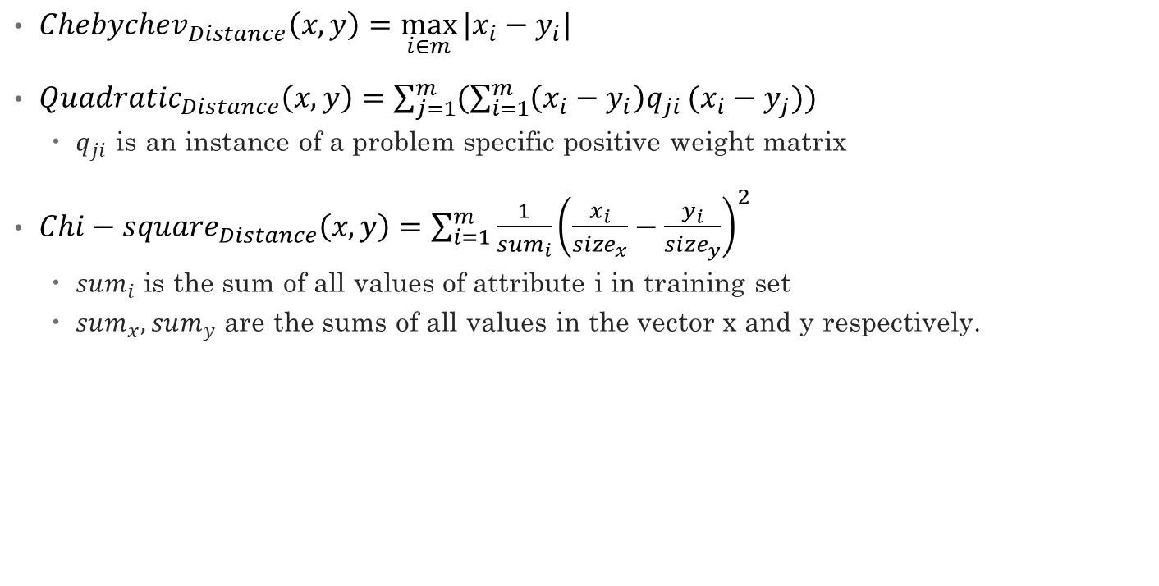
Distance Metrics…
${Chebychev}_{Distance}\left(x,y\right)=\max_{i∈m}{|x_{i}−y_{i}|}$
${Quadratic}_{Distance}\left(x,y\right)=\sum_{j=1}^{m}{(\sum_{i=1}^{m}{\left(x_{i}−y_{i}\right)q_{ji}}(x_{i}−y_{j}))}$
$q_{ji}$ is an instance of a problem specific positive weight matrix
${Chi−square}_{Distance}\left(x,y\right)=\sum_{i=1}^{m}{\frac{1}{sum_{i}}{\left(\frac{x_{i}}{size_{x}}−\frac{y_{i}}{size_{y}}\right)}^{2}}$
$sum_{i}$ is the sum of all values of attribute i in training set
$sum_{x},sum_{y}$ are the sums of all values in the vector x and y respectively.
Notes:
Minkowsky = l-norm

Slide 22
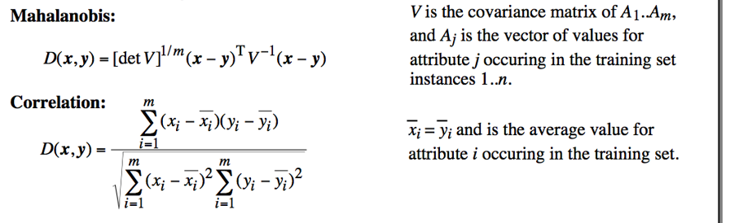
Distance Metrics
Notes:
Minkowsky = l-norm

Slide 23
Issues with Distance Metrics
Most distance measures were designed for linear/real-valued attributes
Two important questions in the context of machine learning:
How best to handle nominal attributes
What to do when attribute types are mixed

Slide 24
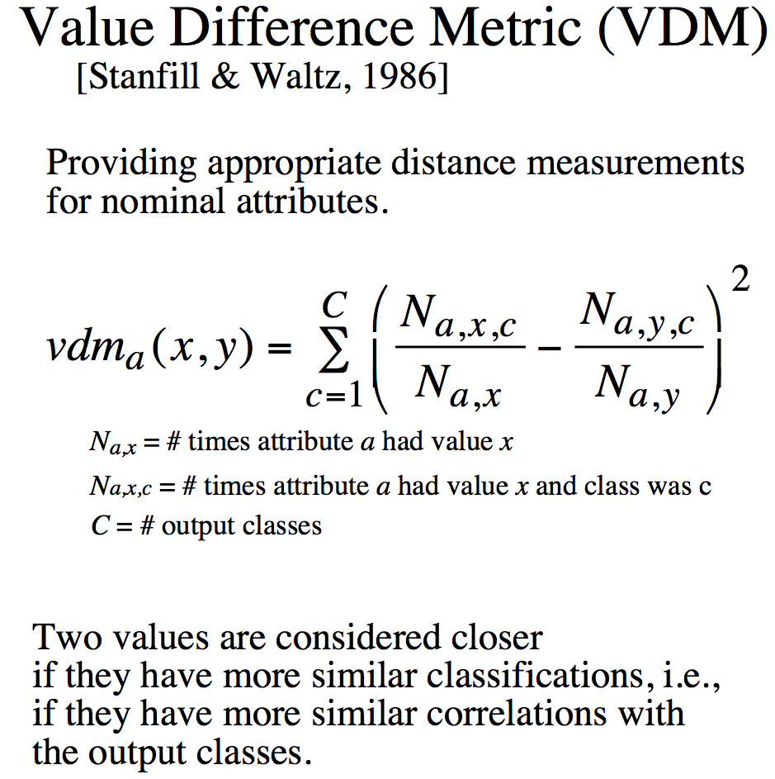
Distance for Nominal Attributes
Notes:
Do a single example here. Shape (Round, Square) 6/10 and 3/5

Slide 25
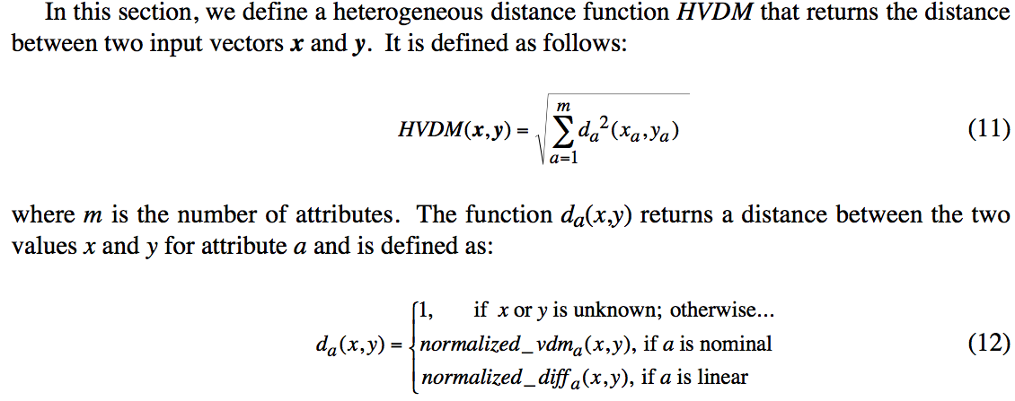
Distance for Heterogeneous Data
Wilson, D. R. and Martinez, T. R., Improved Heterogeneous Distance Functions, Journal of Artificial Intelligence Research, vol. 6, no. 1, pp. 1-34, 1997

Slide 26
Some Remarks
k-NN works well on many practical problems and is fairly noise tolerant (depending on the value of k)
k-NN is subject to the curse of dimensionality (i.e., presence of many irrelevant attributes)
k-NN needs adequate distance measure
k-NN relies on efficient indexing

Slide 27

Distance-weighted k-NN
Replace
$clf\left(q\right)={argmax}_{v∈V}\sum_{i=1}^{k}{g(v,f(x_{i}))}$
by:
$clf\left(q\right)={argmax}_{v∈V}\sum_{i=1}^{k}{\frac{1}{d\left(x_{i},x_{q}\right)}g(v,f(x_{i}))}$

Slide 28
How is kNN Incremental?
All training instances are stored
Model consists of the set of training instances
Adding a new training instance only affects the computation of neighbors, which is done at execution time (i.e., lazily)
Note that the storing of training instances is a violation of the strict definition of incremental learning.

Slide 29
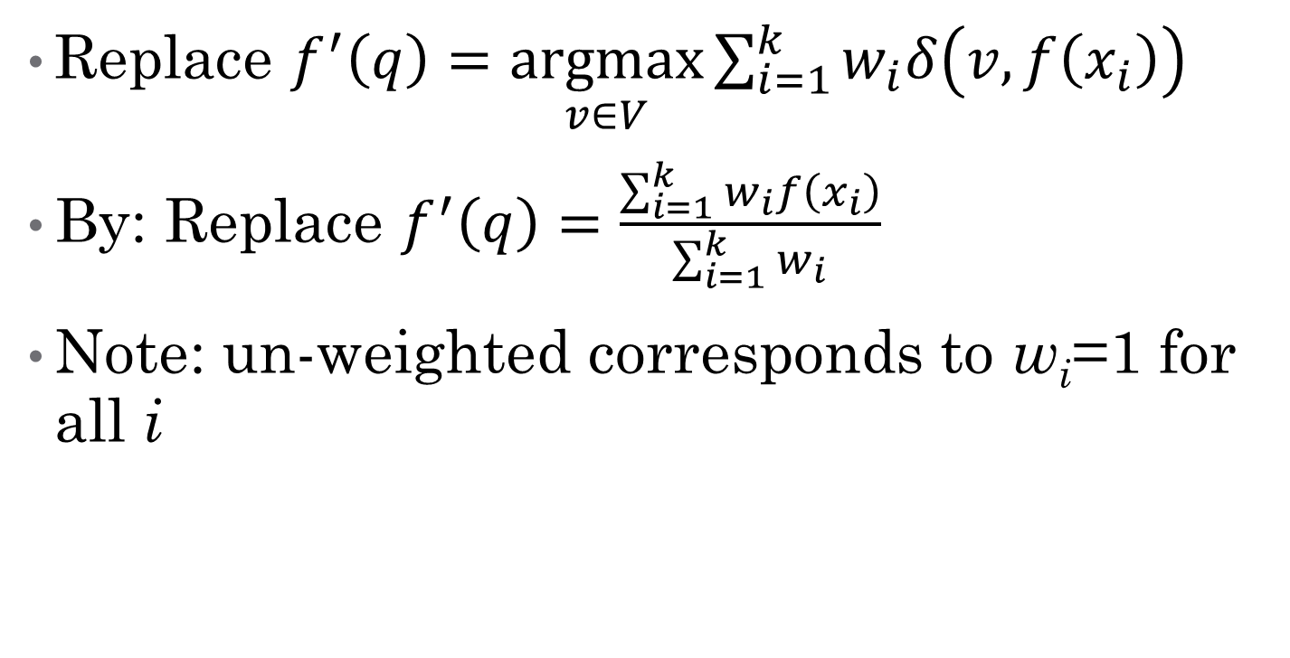
Predicting Continuous Values
Replace $f^{′}\left(q\right)=\underset{v∈V}{argmax}{\sum_{i=1}^{k}{w_{i}δ\left(v,f\left(x_{i}\right)\right)} }$
By: Replace $f^{′}\left(q\right)=\frac{\sum_{i=1}^{k}{w_{i}f\left(x_{i}\right)}}{\sum_{i=1}^{k}{w_{i}}}{ }$
Note: un-weighted corresponds to w_{i}=1 for all i

Slide 30
CS4104 Applied Machine Learning
Bayesian Classifier

Slide 31

Bayesian Theorem
Conditional Probability
$P\left(A | B\right)=\frac{P\left(B,A\right)}{P\left(B\right)}$
Probability of Class C given Attribute A
$P\left(C | A\right)=\frac{P\left(A,C\right)}{P\left(A\right)}$
Bayesian Theorem
$P\left(C | A\right)=\frac{P\left(A | C\right)P\left(C\right)}{P\left(A\right)}$

Slide 32
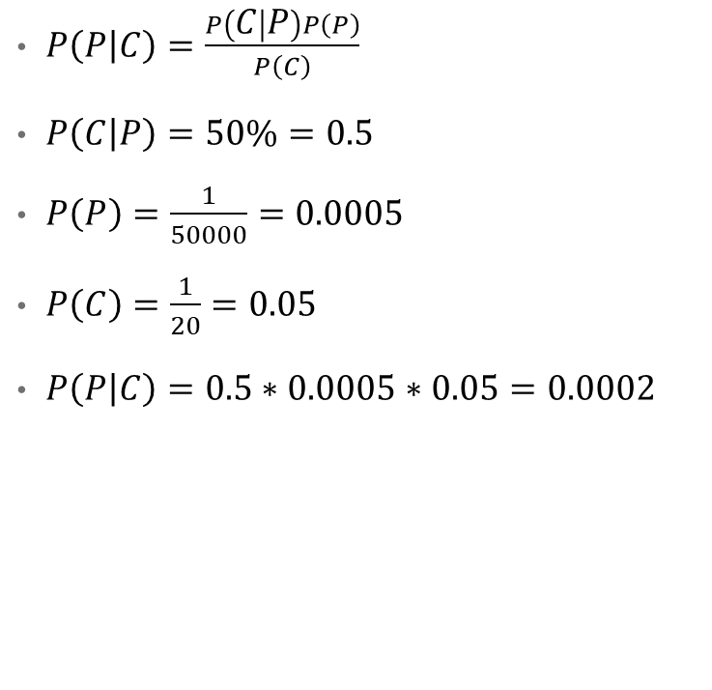
Example
A doctor knows that polyps (P) causes GI-tract Cancer (C) 50% of the time
Prior probability of any patient having Polyps (P) is 1/50,000
Prior probability of any patient having GI-Track Cancer (C) is 1/20
$P\left(P | C\right)=\frac{P\left(C | P\right)P\left(P\right)}{P\left(C\right)}$
$P\left(C | P\right)=50\%=0.5$
$P\left(P\right)=\frac{1}{50000}=0.0005$
$P\left(C\right)=\frac{1}{20}=0.05$
$P\left(P | C\right)=0.5∗0.0005∗0.05=0.0002$

Slide 33

Example 2: [Not Real Case]
As per campus records, 20/400 students completed (C) their degree on time having short of attendance (A) in any subject.
Every 10th student got shortage of attendance.
170 out of 340 students got completed their degree timely.
Compute the probability of shortage of attendance for a student completed his degree timely.
$P\left(A | C\right)=\frac{P\left(C | A\right)P\left(A\right)}{P\left(C\right)}$
$P\left(C | A\right)=20/400=0.05$
$P\left(A\right)=\frac{1}{10}=0.1$
$P\left(C\right)=\frac{170}{340}=0. 5$
$P\left(A | C\right)=0.05∗0.1∗0.5=0.0025$

Slide 34

Bayesian Classifier
Consider each attribute and class label as random variables
Given a record with attributes $(A_{1}, A_{2},…,A_{n})$
Goal is to predict class C
Specifically, we want to find the value of C that maximizes
$P\left(C\right|A_{1}, A_{2},…,A_{n} )$
Can we estimate $P\left(C\right|A_{1}, A_{2},…,A_{n} )$ directly from data?

Slide 35
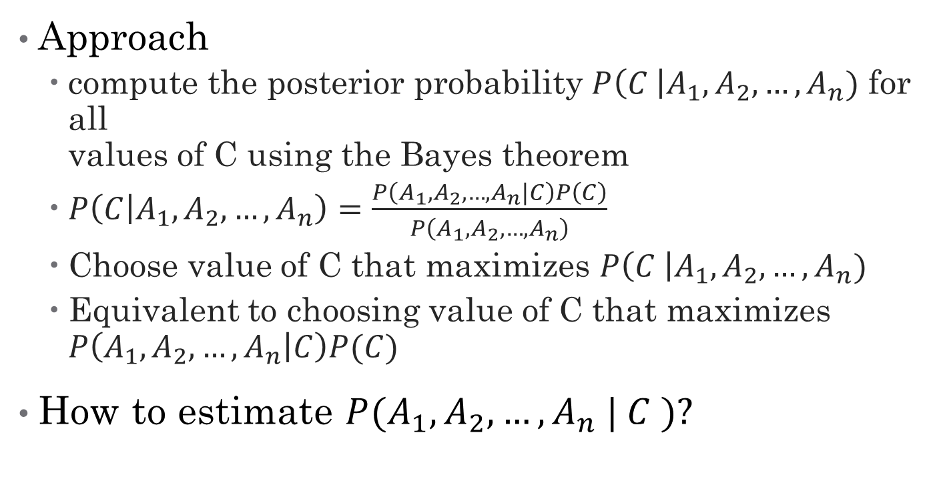
Bayesian Classifier
Approach
compute the posterior probability $P\left(C \right|A_{1}, A_{2}, …, A_{n})$ for all values of C using the Bayes theorem
$P\left(C | A_{1},A_{2},…,A_{n}\right)=\frac{P\left(A_{1},A_{2},…,A_{n}|C\right)P\left(C\right)}{P\left(A_{1},A_{2},…,A_{n}\right)}$
Choose value of C that maximizes $P\left(C \right|A_{1}, A_{2}, …, A_{n})$
Equivalent to choosing value of C that maximizes $P\left(A_{1}, A_{2}, …, A_{n} | C\right)P(C)$
How to estimate $P(A_{1}, A_{2}, …, A_{n} | C )?$

Slide 36

Naïve Bayes Classifier
Assume independence among attributes Ai when class is given:
$P(A_{1}, A_{2}, …, A_{n} |C) = P\left(A_{1}\right|C_{j}) P(A_{2}| C_{j})… P\left(A_{n}\right|C_{j})$
Can estimate $P\left(A_{i}\right|C_{j})$ for all $A_{i}$ and $C_{j}$.
New point is classified to $C_{j}$ if $P\left(C_{j}\right)ΠP\left(A_{i}|C_{j}\right)$ is maximal.

Slide 37
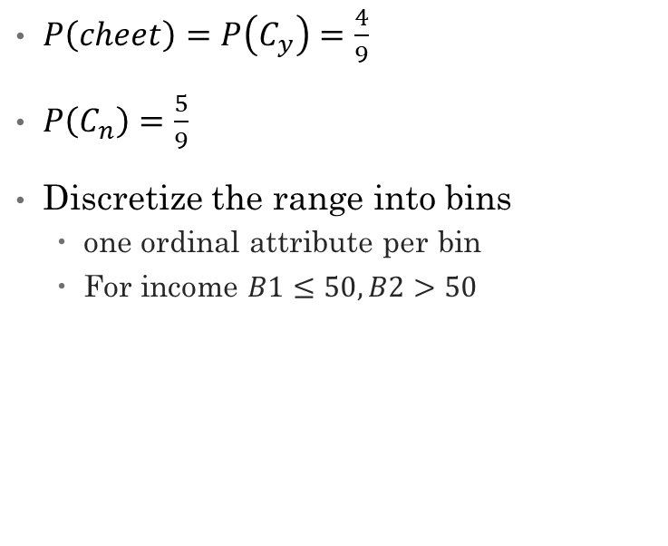
Example
Dataset
Probabilities
Sr# | Refund | Status | Income | Cheat
1 | Yes | 1 | 50K | Yes
2 | No | 2 | 60K | Yes
3 | Yes | 1 | 10K | No
4 | Yes | 1 | 120K | No
5 | Yes | 2 | 101K | No
6 | No | 2 | 18K | Yes
7 | No | 1 | 87K | No
8 | No | 1 | 11K | No
9 | Yes | 2 | 20K | Yes
10 | Yes | 1 | 55K | ?
$P\left(cheet\right)=P\left(C_{y}\right)=\frac{4}{9}$
$P\left(C_{n}\right)=\frac{5}{9}$
Discretize the range into bins
one ordinal attribute per bin
For income $B1≤50,B2>50$

Slide 38
Example
Dataset
Probabilities
Sr# | Refund | Status | Income | Cheat
1 | Yes | 1 | B1 | Yes
2 | No | 2 | B2 | Yes
3 | Yes | 1 | B1 | No
4 | Yes | 1 | B2 | No
5 | Yes | 2 | B2 | No
6 | No | 2 | B1 | Yes
7 | No | 1 | B2 | No
8 | No | 1 | B1 | No
9 | Yes | 2 | B1 | Yes
10 | Yes | 1 | B2 | ?
$P\left(cheet\right)=P\left(C_{y}\right)=\frac{4}{9}$
$P\left(C_{n}\right)=\frac{5}{9}$
Discretize the range into bins
one ordinal attribute per bin
For income $B1≤50,B2>50$

Slide 39
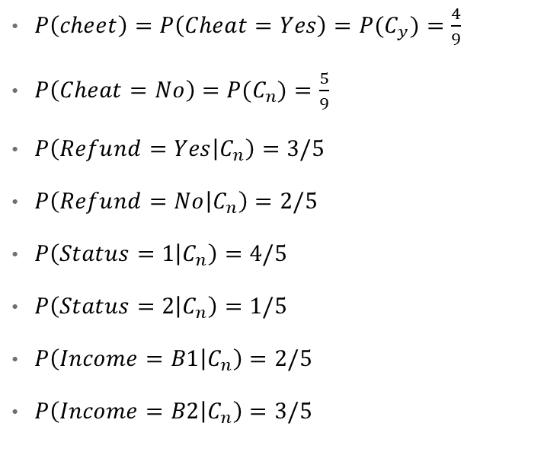
Example
Dataset
Probabilities
Sr# | Refund | Status | Income | Cheat
1 | Yes | 1 | B1 | Yes
2 | No | 2 | B2 | Yes
3 | Yes | 1 | B1 | No
4 | Yes | 1 | B2 | No
5 | Yes | 2 | B2 | No
6 | No | 2 | B1 | Yes
7 | No | 1 | B2 | No
8 | No | 1 | B1 | No
9 | Yes | 2 | B1 | Yes
10 | Yes | 1 | B2 | ?
$P\left(cheet\right)=P\left(Cheat=Yes\right)=P(C_{y})=\frac{4}{9}$
$P\left(Cheat=No\right)=P(C_{n})=\frac{5}{9}$
$P\left(Refund=Yes | C_{n}\right)=3/5$
$P\left(Refund=No | C_{n}\right)=2/5$
$P\left(Status=1 | C_{n}\right)=4/5$
$P\left(Status=2 | C_{n}\right)=1/5$
$P\left(Income=B1 | C_{n}\right)=2/5$
$P\left(Income=B2 | C_{n}\right)=3/5$

Slide 40
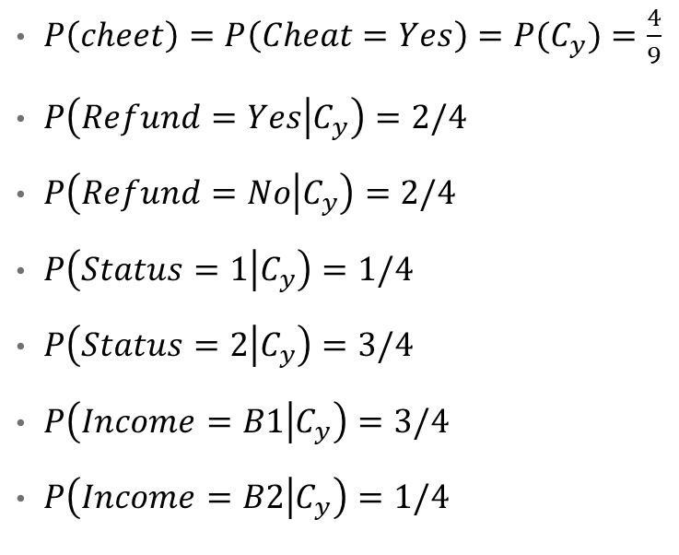
Example
Dataset
Probabilities
Sr# | Refund | Status | Income | Cheat
1 | Yes | 1 | B1 | Yes
2 | No | 2 | B2 | Yes
3 | Yes | 1 | B1 | No
4 | Yes | 1 | B2 | No
5 | Yes | 2 | B2 | No
6 | No | 2 | B1 | Yes
7 | No | 1 | B2 | No
8 | No | 1 | B1 | No
9 | Yes | 2 | B1 | Yes
10 | Yes | 1 | B2 | ?
$P\left(cheet\right)=P\left(Cheat=Yes\right)=P(C_{y})=\frac{4}{9}$
$P\left(Refund=Yes | C_{y}\right)=2/4$
$P\left(Refund=No | C_{y}\right)=2/4$
$P\left(Status=1 | C_{y}\right)=1/4$
$P\left(Status=2 | C_{y}\right)=3/4$
$P\left(Income=B1 | C_{y}\right)=3/4$
$P\left(Income=B2 | C_{y}\right)=1/4$

Slide 41

Example
Probabilities
Test
$P\left(cheet\right)=P\left(Cheat=Yes\right)=P(C_{y})=\frac{4}{9}$
$P\left(Refund=Yes | C_{y}\right)=2/4$
$P\left(Refund=No | C_{y}\right)=2/4$
$P\left(Status=1 | C_{y}\right)=1/4$
$P\left(Status=2 | C_{y}\right)=3/4$
$P\left(Income=B1 | C_{y}\right)=3/4$
$P\left(Income=B2 | C_{y}\right)=1/4$
$P\left(X | C_{y}\right)=P\left(R=Yes,S=1,I=B2 | C=Yes\right)$
$P\left(X | C_{y}\right)=P\left(R=Y | C_{y}\right)∗P\left(S=1 | C_{y}\right)∗P(I=B2|C_{y})$
$P\left(X | C_{y}\right)=0.5∗0.25∗0.25=0.03125$

Slide 42
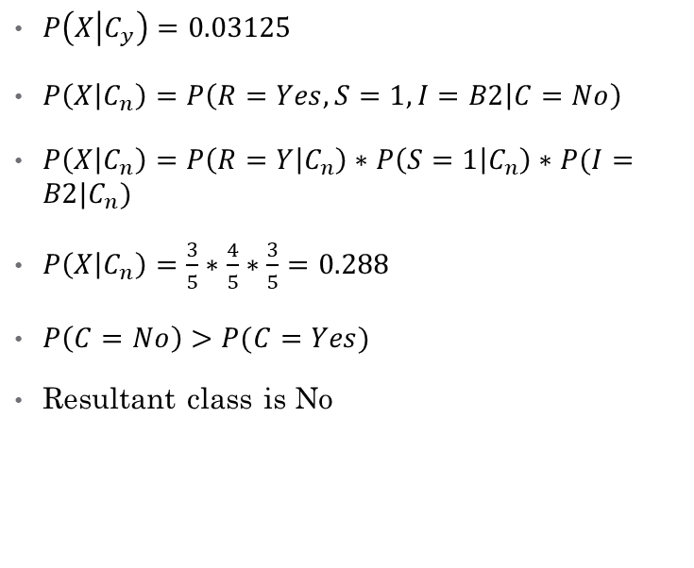
Example
Probabilities
Test
$P\left(cheet\right)=P\left(Cheat=Yes\right)=P(C_{y})=\frac{4}{9}$
$P\left(Cheat=No\right)=P(C_{n})=\frac{5}{9}$
$P\left(Refund=Yes | C_{n}\right)=3/5$
$P\left(Refund=No | C_{n}\right)=2/5$
$P\left(Status=1 | C_{n}\right)=4/5$
$P\left(Status=2 | C_{n}\right)=1/5$
$P\left(Income=B1 | C_{n}\right)=2/5$
$P\left(Income=B2 | C_{n}\right)=3/5$
$P\left(X | C_{y}\right)=0.03125$
$P\left(X | C_{n}\right)=P\left(R=Yes,S=1,I=B2 | C=No\right)$
$P\left(X | C_{n}\right)=P\left(R=Y | C_{n}\right)∗P\left(S=1 | C_{n}\right)∗P(I=B2|C_{n})$
$P\left(X | C_{n}\right)=\frac{3}{5}∗\frac{4}{5}∗\frac{3}{5}=0.288$
$P\left(C=No\right)>P(C=Yes)$
Resultant class is No

Slide 43

Continues Variables Probabilities
$P\left(A_{i} | C_{j}\right)=\frac{1}{\sqrt{2πσ^{2}}}e^{\frac{{\left(A_{i}−μ\right)}^{2}}{2σ^{2}}}$
$μ=mu=mean$
$μ=\frac{\sum_{i∈n}{x_{i}}}{n}$
$σ^{2}=sigma=variance$
$σ^{2}=\frac{\sum_{i∈n}{x_{i}−μ\left(x\right)}}{n−1}$

Slide 44
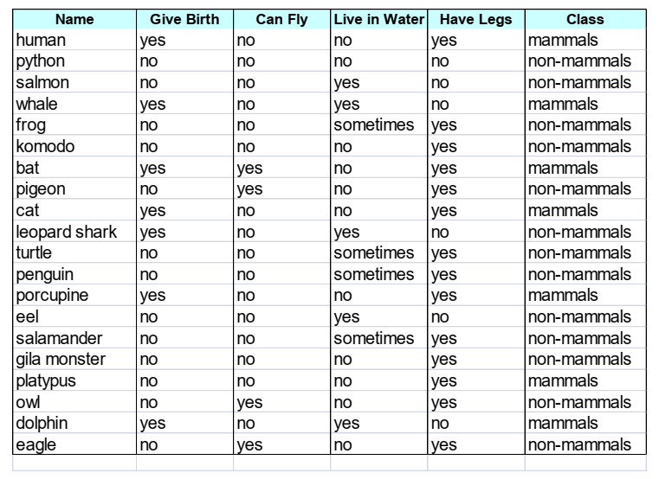

Exercise

Slide 45
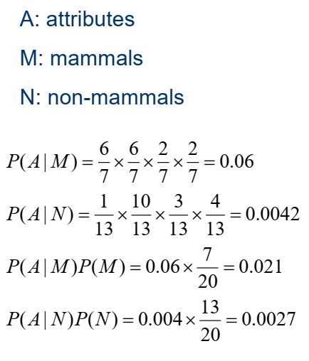
Solution: Train

Slide 46
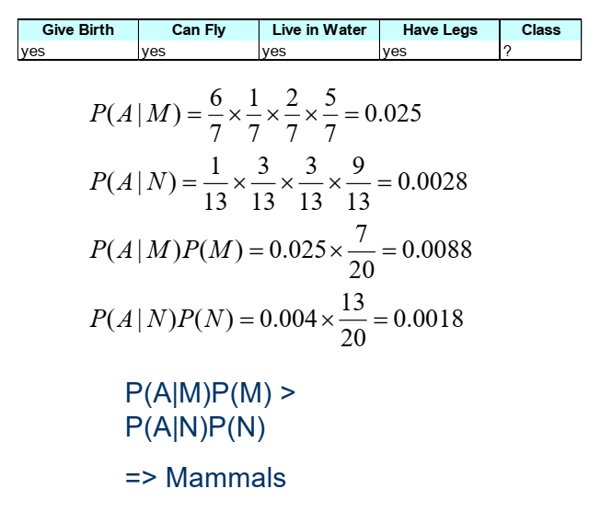
Solution : Test

Slide 47
Naïve Bayes Analysis
Robust to isolated noise points
Handle missing values by ignoring the instance during probability estimate calculations
Robust to irrelevant attributes
Independence assumption may not hold for some attributes
Use other techniques such as Bayesian Belief Networks (BBN)

